Slide 1
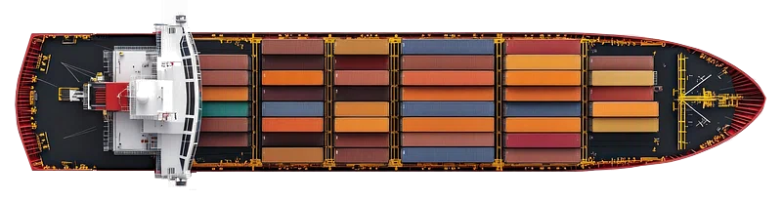
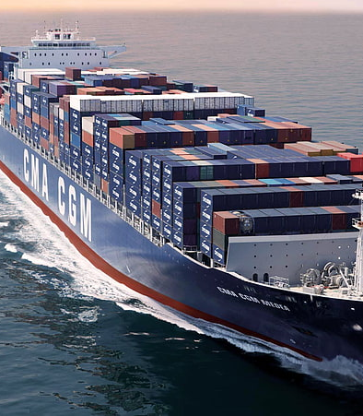
Implementation of A.I. in shipping ports
Using A.I. for port management
Kilo Jameson, hackathon team

Slide 2
Implementation of A.I. in shipping ports
Have you ever had your ordered parcel delayed?
Give a late birthday present?
Wait an extra few days to pick up your G-Class?
Kilo Jameson, hackathon team
We definitely have!
And it’s frustrating…

Slide 3
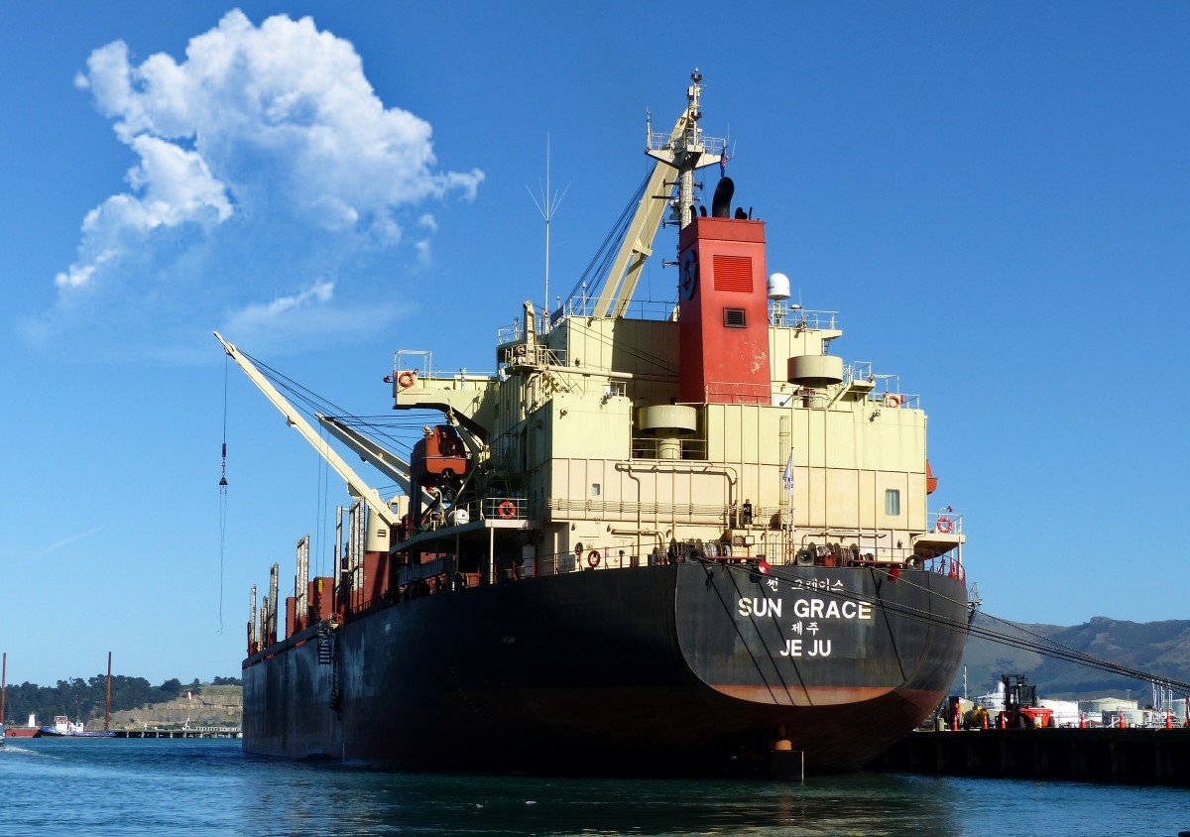
Ports
The blood-flow of global trade and transportation of goods
Central role in the economical development of countries
Engineering marvels

Slide 4
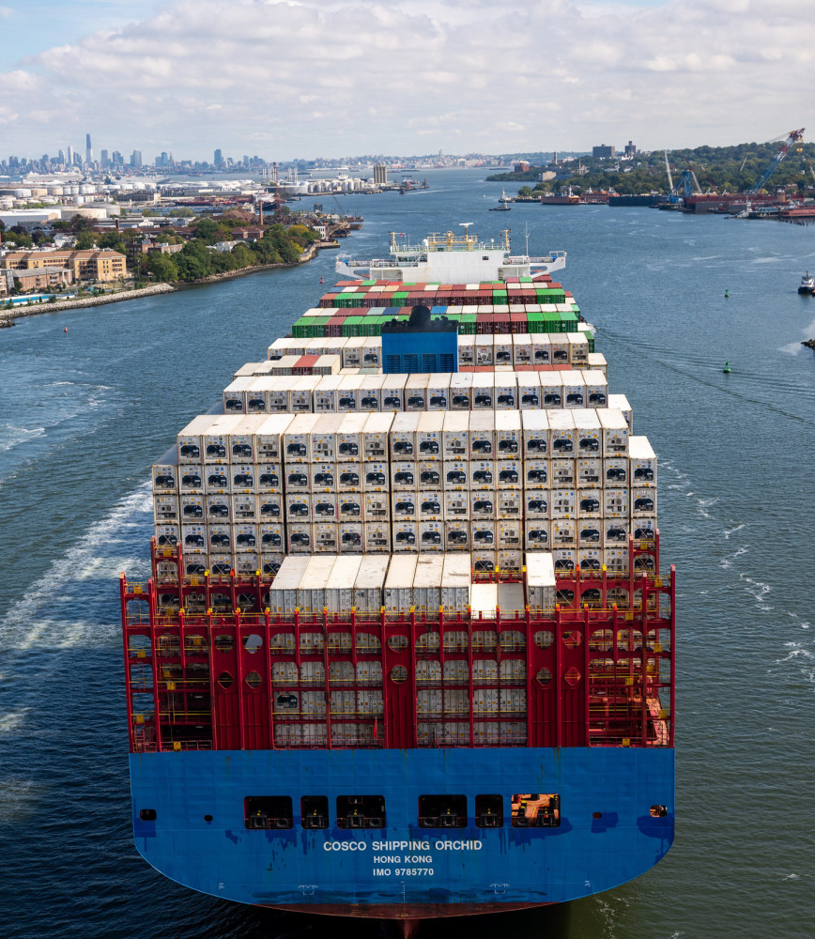
The problem?
Slow
Costly mistakes
A lot to organize

Slide 5
Introduce A.I.
Reduce human errors
Trained model makes accurate predictions
Suggests the next most optimal move
Minimize wasted time
Optimize efficiency through statistical decision-making

Slide 6

Our idea
An A.I. that makes decisions based on statistics and fed information
A.I. model is trained to take into account a variety of information, such as:
Estimated arrival and departure time of vessels
Berth size and availability
Vessel size and load
Type of load being transported
Weather conditions
Machinery problems
Possible risks

Slide 7
A.I. determines the next most optimal step to take
Then, as a helper, suggests it to the user, leaving the final decision for the human to confirm, should the decision of the A.I. be inadequate for the moment.
A dynamic UI gives the worker a view of all the necessary information
Interactive and slick design
Window showcasing an overview of the vessels and berths in real time
Trained A.I. executes complex algorithms to also predict potential risks, defects and equipment malfunctions and warns the user.

Slide 8
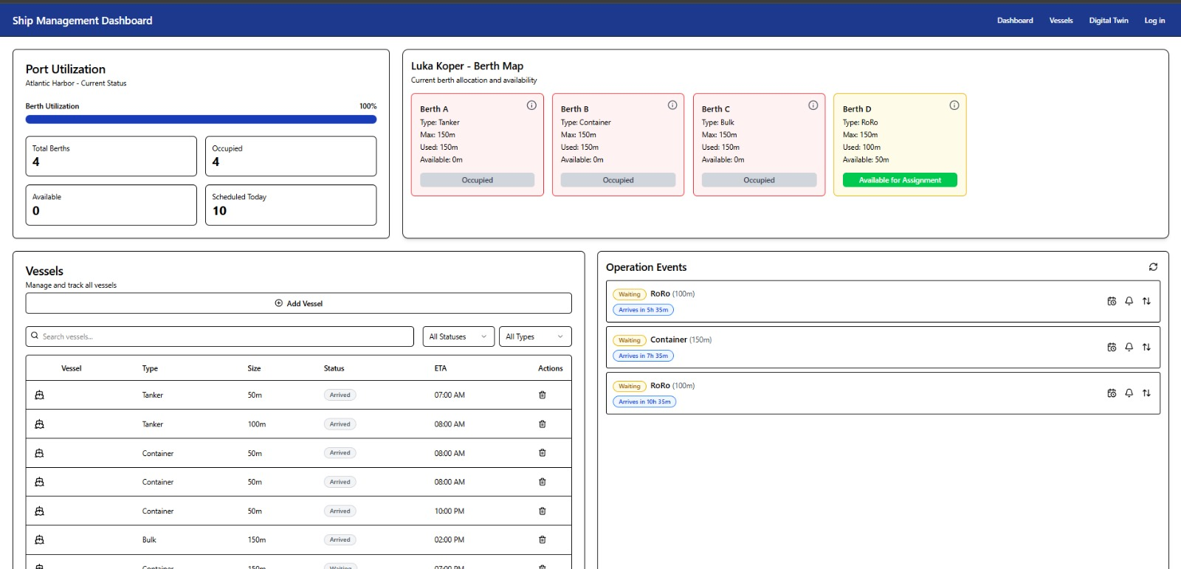
UI for ship management in Luka Koper

Slide 9


Slide 10


